Slide 1
Trajectory Planning for Conflict Free Trajectories A Multi-Agent Reinforcement Learning Approach
Alevizos Bastas, George A. Vouros
Collaborating Organizations
University of Piraeus Research Center (UPRC), Greece
Centro de Referencia I+D+i ATM (CRIDA), Spain

Slide 2
Contents
Phd Objective
Operational Context
Specific objectives – methodology
What has been done so far
Imitation learning for Conflicts Free Trajectory Planning
Problem formulation
Modelling ATCOs reactions
Evaluation
Concluding remarks
What has been achieved
Next Steps

Slide 3
Phd objective
Explore and present novel algorithms towards planning conflict-free trajectories at the pre-tactical phase of operations in computationally efficient ways, for large number of trajectories following a methodology combining data-driven and agent-based approaches.
Data-driven: Revealing patterns of the stakeholders behavior from historical data generating conflict free trajectories .
Agent-based: Agents, representing flights, aim to evolve conflict free trajectories jointly with others.

Slide 4
Operational Goals
Increase predictability of trajectories, in conjunction to detecting and resolving potential conflicts among trajectories
Eliminate potential en-route conflicts at the pre-tactical phase
Reducing ATCO’s workload
Enabling them to deal with complex traffic situations
Increasing the capacity of airspace
Reduce the mismatch between planned and flown trajectories
Reduce uncertainty of operations
Better planning of operations for Airspace Users, etc

Slide 5
Operation context envisioned
5
NM proposes Conflict Free Trajectory
3
Sends accepted trajectory to ATCOs
AUs
Network Manager
ATCOs
1
2
4
constructs a flight plan that sends to the NM
Production of Conflict Free trajectories
Historical CF trajectories
ATCO events
Contextual data such as weather
AU accepts the proposed trajectory

Slide 6
Specific objectives - methodology
Prediction of trajectories at the pre-tactical level
Resolve conflicts between predicted trajectories, taking into account uncertainties of trajectories’ evolution in a multi-agent setting (one agent per flight)
Using a combination of
Data-Driven methods that, based on historical data, learn
Patterns of trajectories’ evolution and patterns of applying conflict resolution actions
Agent-Based methods using Reinforcement Learning methods towards
Predicting conflict-free (CF)Trajectories

Slide 7
Specific objectives – methodology-workplan

Slide 8
What has been done so far
Trajectory prediction¹:
Formulated the trajectory prediction problem (per origin destination pair) as an imitation learning problem where:
Given historical 4D aircraft trajectories whose states include 3D aircraft position with timestamps, in conjunction to forecasted weather conditions at each state.
We derive, using Imitation Learning (GAIL) a description of how the aircraft is to transit among subsequent states starting from an initial state and on as a function of:
(a) the current flight conditions (an initial state with forecasted weather conditions)
(b) a forecast of weather conditions at specific positions
Conflict Resolution:
We formulate the problem of conflicts free trajectory planning as an imitation learning problem, aiming to learn ATCO reactions.
Formal Specification of the problem of modelling ATCO’s behavior: Predicting when the Air Traffic controller will react towards resolving a conflict, and how he/she will react.
Use a deep learning method for predicting ATCO reactions;

Slide 9
Imitation learning for conflict free trajectory planning

Slide 10
Preliminaries-Imitation learning
Agent: Autonomous entity making decision according to its interests also in collaboration with others.
Environment: The “world” in which the agent operates.
Policy: A function mapping states (or observations from states) to distributions of actions.
Imitation learning: The problem of learning a policy to act according to the behavior demonstrated in the dataset.
dataset
environment
policy
agent

Slide 11
Conflicts Free Trajectory Planning-Problem formulation
Given:
A set of historical trajectories with
the corresponding historical ATCO actions
We want agents to learn a policy close to the demonstrated ATCO behavior:
Generating flight trajectories close to the demonstrated historical trajectories under specific circumstances (e.g. weather conditions)
Generating ATCO resolution actions for potential conflicts according to demonstrated historical ATCO resolution actions

Slide 12
Focus: Modelling ATCO’s reactions
ATCO res action point
Considering a single agent problem (corresponding to the focal trajectory)
The focus is on predicting
when the ATCO would issue a resolution action
i.e., determining the exact time point t_{A}, s.t. t ≤ t_{A} ≤ t_{c} , for issuing a resolution action
and
2) how the ATCO would react (which resolution action the ATCO would issue, if any)
i.e., deciding the resolution action to be applied (if any)
position_{t}
Focal trajectory

Slide 13
When to react: ATCOs modes
At each time point t while the trajectory evolves the ATCO may detect a conflict and decide whether he/she will issue a resolution action.
According to that we consider the following modes of ATCO’s behavior :
C0: No conflict no resolution action
C1: Conflict detected, and resolution action applied
C2: Conflict detected but no resolution action applied at this point
Aiming to predict when a resolution action will be applied, we aim to predict the the ATCO mode of behavior at each each time point t as the trajectory evolves.

Slide 14
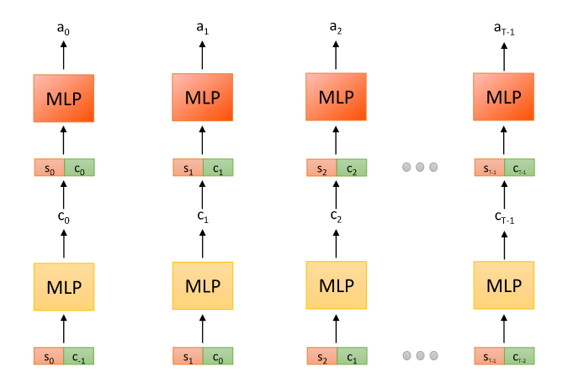
Predicting ACTO’s Reaction Computational Approach : Variational Auto-Encoder (VAE)¹
C0: No conflict no resolution action
C1: Conflict detected, and resolution action applied
C2: Conflict detected but no resolution action applied at this point
Decoder
π
Encoder
q
t₀
t₁
t₂
t_{T}
$$L\left(π,q\right)=−𝔼_{c^{t}\sim q,\left(a^{t} , s^{t}\right)\sim p_{data}}\left[\log{π\left(a^{t} | s^{t},c^{t}\right)}\right]−𝔼_{\left(c^{t} , c^{t−1} , s^{t}\right)\sim p_{data}}\left[logq\left(c^{t} | c^{t−1},s^{t}\right)\right]$$
1. Kingma, Diederik P., and Max Welling. "Auto-encoding variational bayes." arXiv preprint arXiv:1312.6114 (2013).

Slide 15
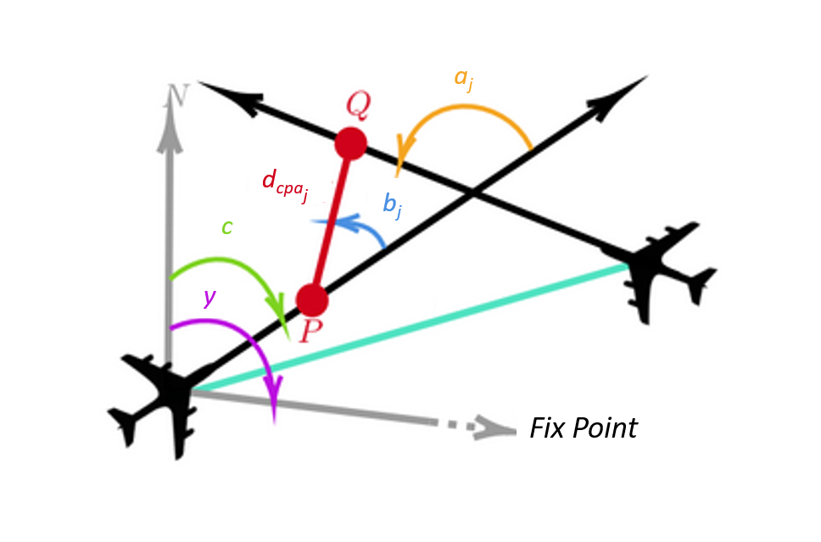
State Observations (per neighboring flight)
$$\left[\begin{aligned}d \\ sin⁡(c−y) \\ cos(c−y) \\ u_{h} \\ u_{v} \\ altitude \\ \begin{aligned}t_{cpa} \\ d_{cpa} \\ t_{cp} \\ d_{cp} \\ sin⁡(a_{j}) \\ cos(a_{j}) \\ sin(b_{j}) \\ cos(b_{j})\end{aligned}\end{aligned}\right]$$
distance from fixed point
bearing relative to fixpoint
horizontal speed
vertical speed
altitude
CPA
Crossing point
Relative Angles between ownship and neighbor

Slide 16
Actions to be predicted
$$\left[\begin{aligned}A_{0}:No resolution action \\ A_{1}:Direct to waypoint \\ A_{2}:Speed change \\ \\ Δc:Change in course \\ Δu_{h}:Change in horizontal speed \\ Δu_{v}:Change in vertical speed \\ \\ Δt:Time difference to the next trajectory point\end{aligned}\right]$$

Slide 17
Training the model: Dataset’s Inherent limitations
The dataset comprises:
Historical flown trajectories
Historical ATCO resolution actions
Dataset inherent limitations
Does not include the features that cause the ATCO reactions
Dataset imbalance w.r.t. modes of ATCO behaviour.

Slide 18
Resolving dataset’s inherent limitations
How to reveal the ATCO observations.
Simulating uncertainty in trajectory evolution
How to approach the dataset imbalance issue.
Subsampling for majority classes and data augmentation (introducing new samples) for minority classes of modes.

Slide 19
Overall Process
Simulating Uncertainty in Trajectory Evolution
Identification of neighboring flights
&
Detection of Conflicts
VAE (Modelling)
Data Augmentation &
Subsampling
Training Set
Model
Test Set
ATCO Reaction

Slide 20
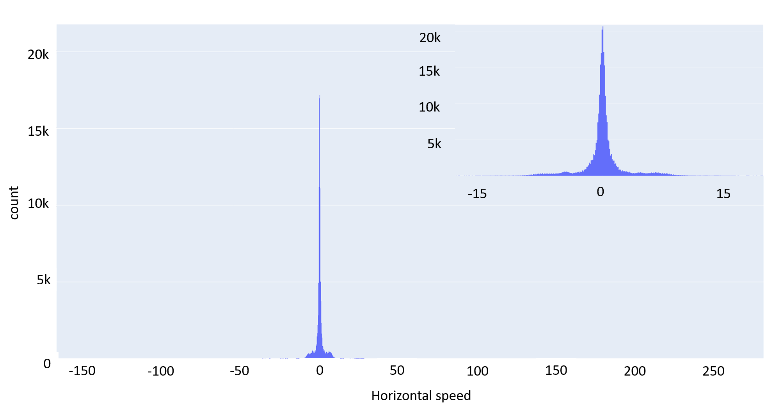
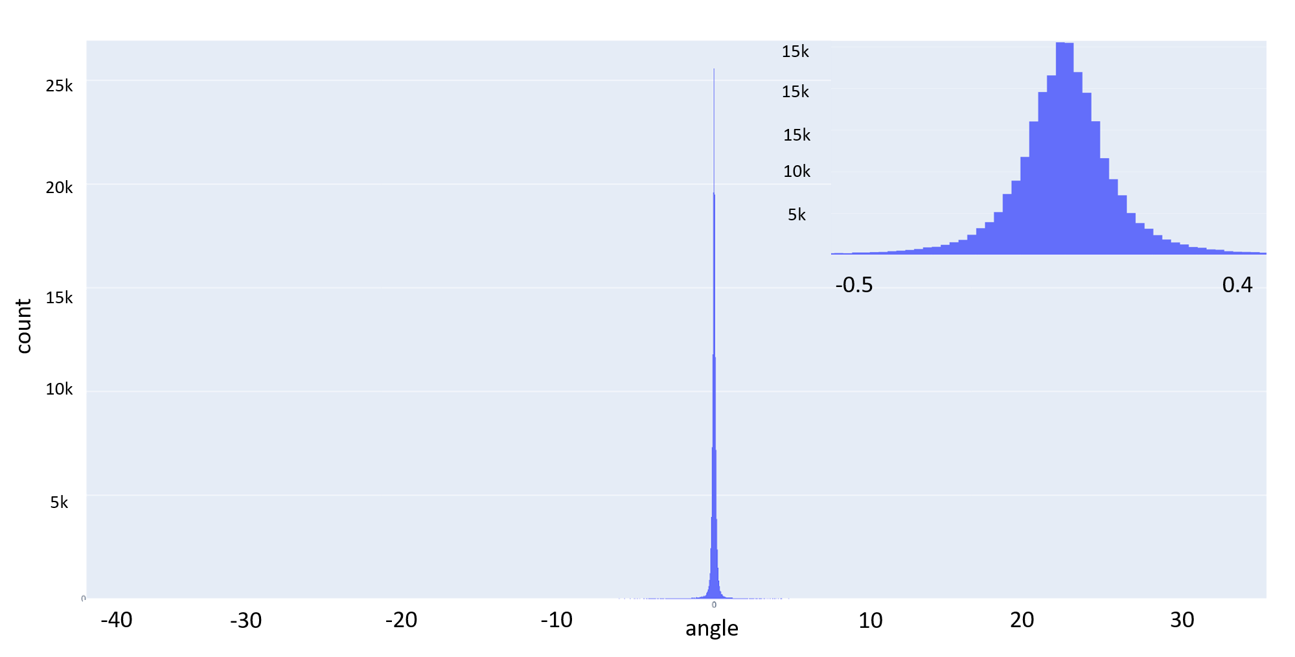
Simulating uncertainty in trajectory evolution
Problem: At each time point, the future position of the aircraft is uncertain.
Approach: At each time point, we project the position of the aircraft into the future using the current horizontal speed and direction (as computed between the current and previous trajectory points) using statistics of:
$Δspeed \left(Δs\right)$
$Δcourse (Δc)$
Δs
Example of the distribution of the difference of the horizontal speed’s magnitude between consecutive trajectory points of the trajectories between LPPT LFPO
Δc
Example of the distribution of the difference of the aircraft’s course between consecutive trajectory points of the trajectories between LPPT LFPO

Slide 21
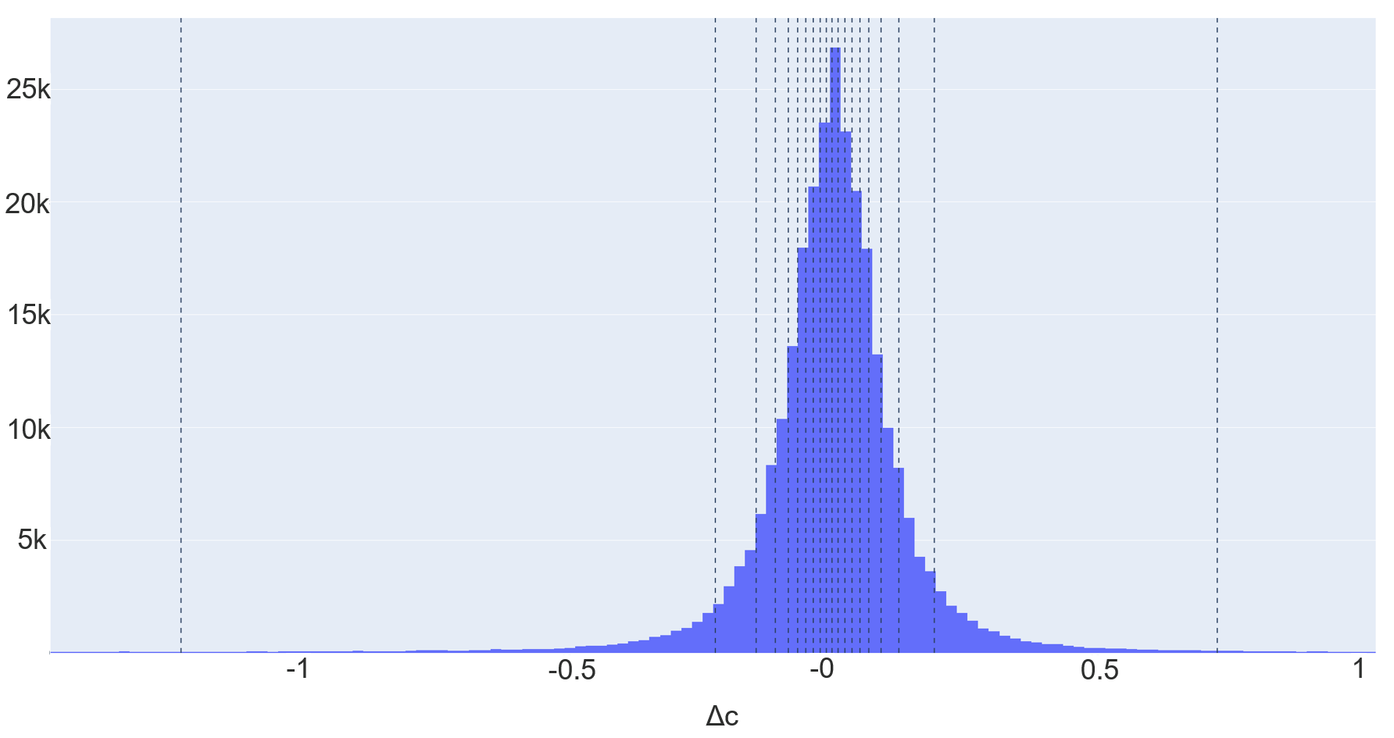
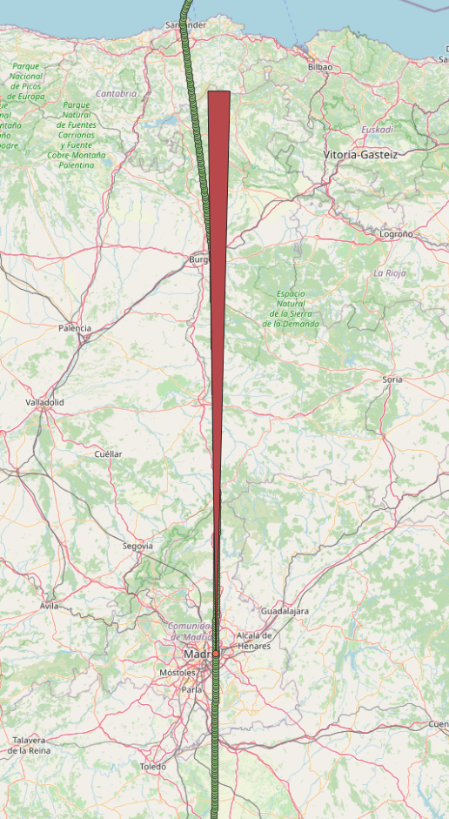
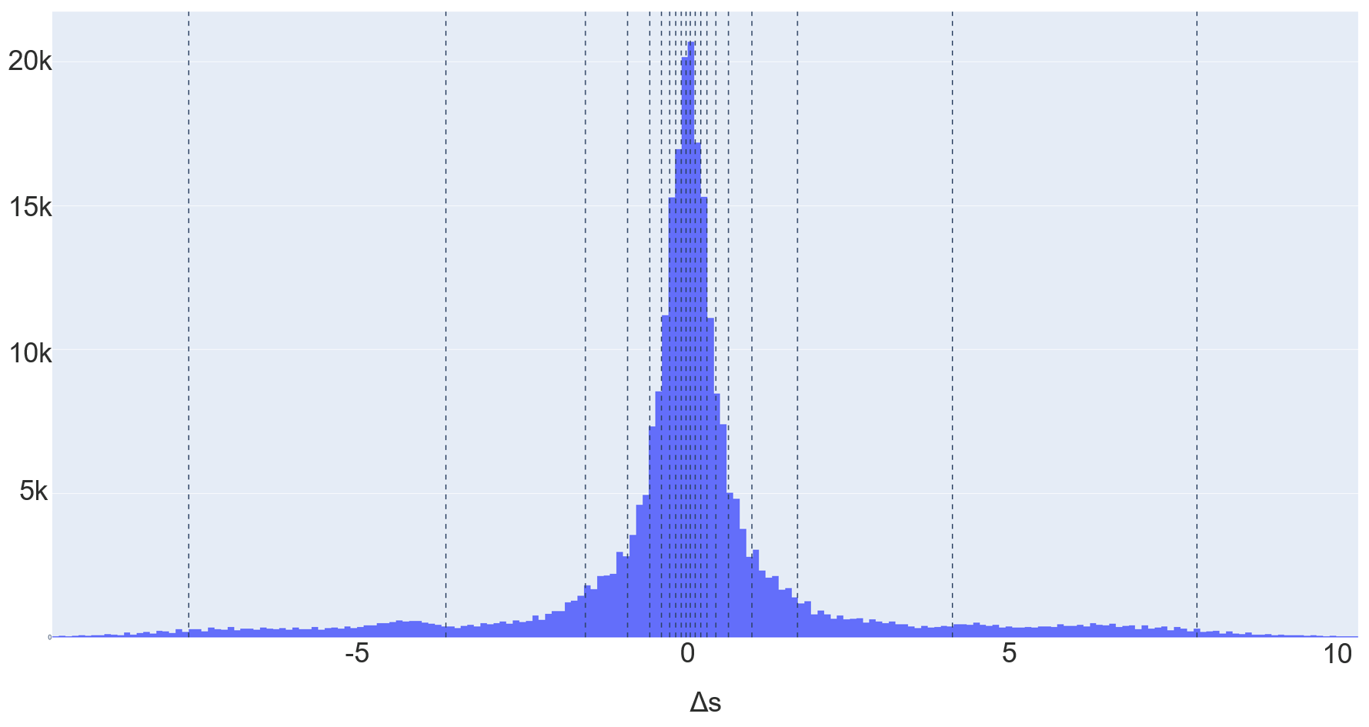
Simulating uncertainty in trajectory evolution
Divide values of $Δc$ and $Δs$ in 20 equi-height bins
Use median value of each bin as the bin’s representative value
Add each representative value to the current velocity of the aircraft resulting to 21x21 different velocities
At this point we have 21x21 potential trajectory evolutions and we have to consider for potential conflicts for any of these
Compute the CPA between the aircraft and neighboring flights according to each one of these trajectory evolutions.
Consider the potential trajectory which results to the minimum distance at the CPA.
Compute the state observations w.r.t. the considered trajectory evolution .

Slide 22
Overall Process
Simulating Uncertainty in Trajectory Evolution
Identification of neighbors
&
Detection of Conflicts
VAE (Modelling)
Data Augmentation &
Subsampling
Training Set
Model
Test Set
ATCO Reaction

Slide 23
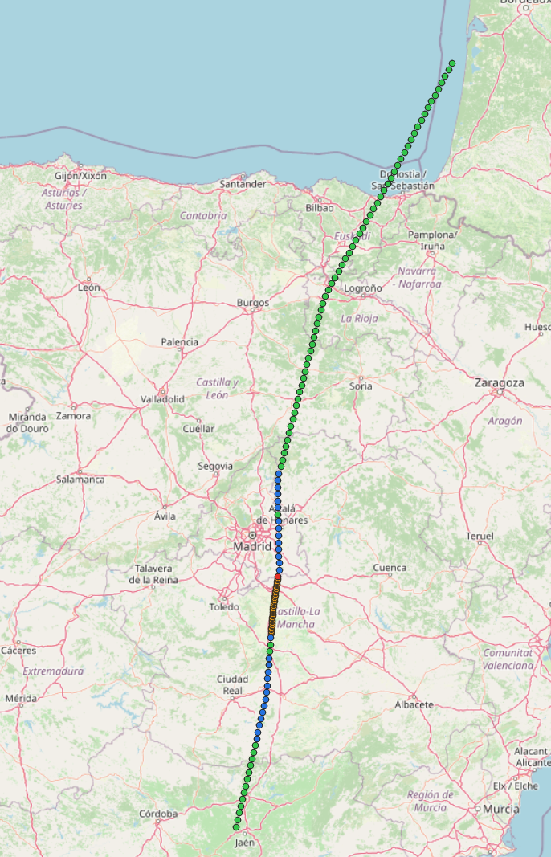
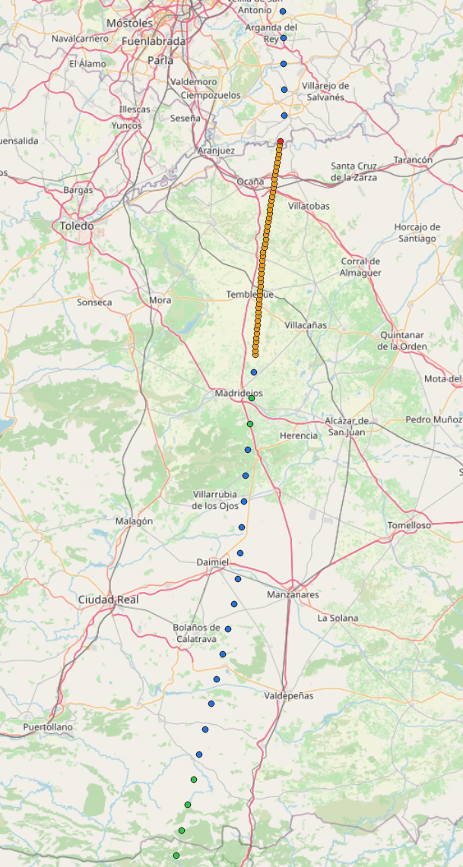
Dataset Preprocessing-Dataset imbalance
Problem: The dataset is imbalanced considering the trajectory points with different modes and the ATCO reactions. The typical case is to have one resolution action point for a trajectory consisting of 700 point. So, modes are imbalanced.
Approach: Subsampling-Resampling (introducing new samples) also incorporating the uncertainty of ATCO’s decision about the time to issue a resolution action when detecting a conflict.
Resolution action
Conflict and Resolution action annotation
Conflict no resolution action annotation
No Conflict no resolution action annotation

Slide 24
Overall Process
Simulating Uncertainty in Trajectory Evolution
Identification of neighboring flights
&
Detection of Conflicts
VAE (Modelling)
Data Augmentation &
Subsampling
Training Set
Model
Test Set
ATCO Reaction

Slide 25
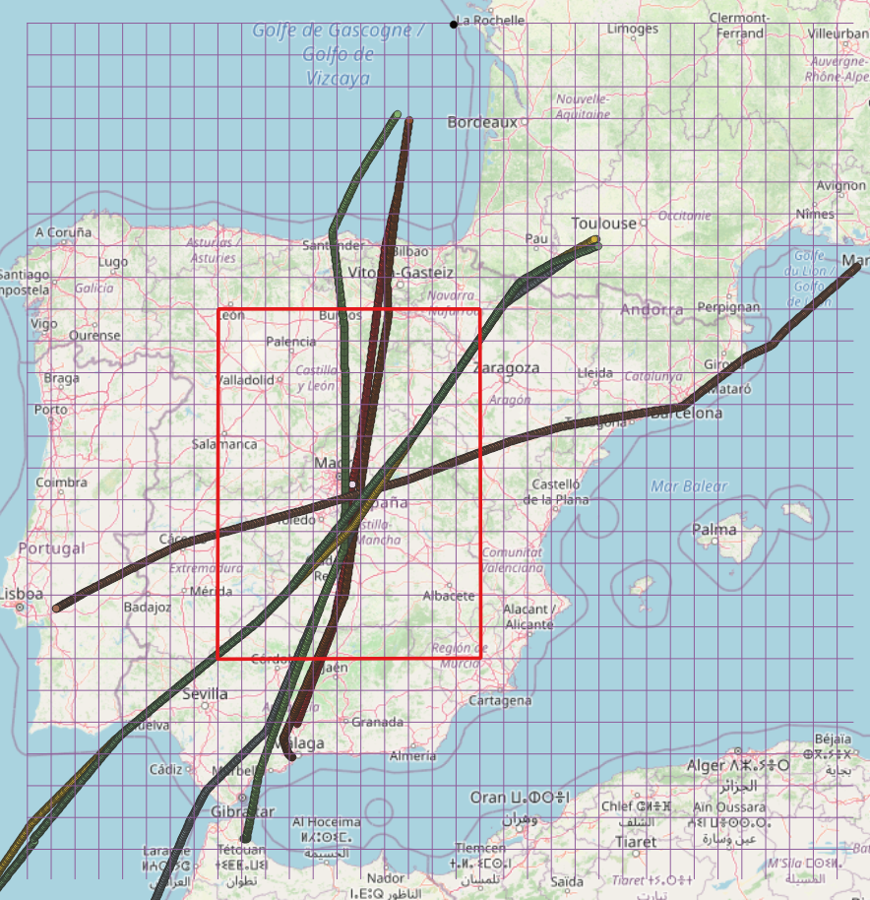
Neighbors and Conflicts
Two evaluation settings
Sector related
Sector ignorant (Free Route CDR)
Crossing and CPA rules: In either case the models consider the subset of neighboring flights that:
Crosses paths with the ownship in <= 20 minutes
The closest point of approach is <= 15 NM
Time to CPA is <= 30 minutes
Have an altitude difference w.r.t to the ownship < separation minimum
Have not crossed the crossing point

Slide 26
Overall Process
Simulating Uncertainty in Trajectory Evolution
Identification of neighbors
&
Detection of Conflicts
VAE (Modelling)
Data Augmentation &
Subsampling
Training Set
Model
Test Set
ATCO Reaction

Slide 27
Evaluation: Training & Testing sets
Split the dataset to training and test sets and fit the model
80% training, 20% test using 5-fold cross validation
How to measure accuracy in prediction of ATCOs behavior:
Precision, Recall and F1-Score
We further propose: Weighted precision, weighted recall, weighted f1 score

Slide 28
Experimental Evaluation-Evaluation methodology
Weight errors according to the temporal distance from points with a resolution action to account for the uncertainty of ATCO’s decision about the time to issue a resolution action
Example: Predicting a resolution action 5 seconds later than the assigned resolution should not be penalized as heavily as predicting a resolution action 5 minutes later.
$WP=\frac{TP}{TP+FP}=\frac{\sum_{i=1}^{\#TP}{1}+\sum_{i=1}^{\#FP}{\left(1−w_{fp_{i}}\right)}}{\left[\sum_{i=1}^{\#TP}{1}+\sum_{i=1}^{\#FP}{\left(1−w_{fp_{i}}\right)}\right]+\sum_{i=1}^{\#FP}{\left(w_{fp_{i}}\right)}}=\frac{\sum_{i=1}^{\#TP}{1}+\sum_{i=1}^{\#FP}{\left(1−w_{fp_{i}}\right)}}{\sum_{i=1}^{\#TP}{1}+\sum_{i=1}^{\#FP}{1}}$
$WR=\frac{TP}{TP+FN}=\frac{\sum_{i=1}^{\#TP}{1}+\sum_{i=1}^{\#FP}{\left(1−w_{fp_{i}}\right)}}{\left[\sum_{i=1}^{\#TP}{1}+\sum_{i=1}^{\#FP}{\left(1−w_{fp_{i}}\right)}\right]+\sum_{i=1}^{\#FN}{\left(w_{fn_{i}}\right)}}$
$WF1=2∗\frac{WP∗WR}{WP+WR}$

Slide 29
Experimental Evaluation - Evaluation methodology – Weighted Metrics-Formula
Modes C0,C2:
FP
Dataset indicates C1 and model predicts C0 or C2
$w_{fp}=f\left(x\right), x=|t_{p}−t_{a}|$
Dataset indicates C0 ( or C2) and model predicts C2 (or C2)
$w_{fp}=1$, we do not tolerate the error
FN
Dataset indicates C0 (or C2) and model predicts C1
$w_{fn}=\text{1− }f\left(x\right), x=|t_{p}−t_{a}\text{|}$
Dataset indicates C0 (or C2) and model predicts C2 (or C0)
$w_{fn}=1$, we do not tolerate the error
Mode C1:
FP
Dataset indicates C0 ( or C2) and model predicts C1
$w_{fp}=1−f\left(x\right), x=|t_{p}−t_{a}|$
FN
Dataset indicates C1 and model predicts C0 or C2
$w_{fn}=f\left(x\right), x=|t_{p}−t_{a}|$

Slide 30
Experimental Evaluation-Dataset
Setting | #Trajectories |  |  | #Resolution Actions | Focal Trajectories OD pairs | Res Actions | Year
 | Total | Training | Test
Sector Ignorant | 668 | 534 | 136 | 791 | LEMG-EGGK LEMG-EHAM LPPT-LFPO LSGG-LPPT LSZH-LPPT | A1: Speed change A2: Direct to Waypoint | 2017
Sectors | 255 | 204 | 51 | 344
10 experiments by 5-fold cross validation
80% training
20% testing

Slide 31
Experimental Evaluation-Results
Setting | Model | Modes | Modes weighted | Actions | Actions weighted
Sector ignorant | VAE | precision C0: 1.000 +- 0.000 C1: 0.740 +- 0.018 C2: 0.761 +- 0.035 recall C0: 1.000 +- 0.000 C1: 0.791 +- 0.047 C2: 0.699 +- 0.037 f1 C0: 1.000 +- 0.000 C1: 0.762 +- 0.019 C2: 0.727 +- 0.019 | precision C0: 1.000 +- 0.000 C1: 0.760 +- 0.018 C2: 0.957 +- 0.005 recall C0: 1.000 +- 0.000 C1: 0.954 +- 0.009 C2: 0.759 +- 0.038 f1 C0: 1.000 +- 0.000 C1: 0.845 +- 0.011 C2: 0.846 +- 0.023 | precision A0: 0.895 +- 0.012 A2: 0.493 +- 0.031 A3: 0.643 +- 0.029 recall A0: 0.917 +- 0.008 A2: 0.494 +- 0.039 A3: 0.553 +- 0.045 f1 A0: 0.907 +- 0.006 A2: 0.492 +- 0.027 A3: 0.590 +- 0.028 | precision A0: 0.981 +- 0.002 A2: 0.510 +- 0.031 A3: 0.660 +- 0.031 recall A0: 0.931 +- 0.009 A2: 0.711 +- 0.041 A3: 0.695 +- 0.032 f1 A0: 0.955 +- 0.005 A2: 0.591 +- 0.026 A3: 0.676 +- 0.022
 | Encoder | precision C0: 1.000 +- 0.000 C1: 0.725 +- 0.023 C2: 0.758 +- 0.027 recall C0: 1.000 +- 0.000 C1: 0.798 +- 0.029 C2: 0.671 +- 0.046 f1 C0: 1.000 +- 0.000 C1: 0.759 +- 0.012 C2: 0.710 +- 0.028 | precision C0: 1.000 +- 0.000 C1: 0.747 +- 0.022 C2: 0.956 +- 0.006 recall C0: 1.000 +- 0.000 C1: 0.958 +- 0.006 C2: 0.733 +- 0.045 f1 C0: 1.000 +- 0.000 C1: 0.836 +- 0.014 C2: 0.827 +- 0.031 | - | -

Slide 32
Experimental Evaluation-Results
Setting | Model | Modes | Modes weighted | Actions | Actions weighted
Sectors | VAE | precision C0: 1.000 +- 0.000 C1: 0.733 +- 0.032 C2: 0.560 +- 0.045 recall C0: 1.000 +- 0.000 C1: 0.643 +- 0.062 C2: 0.655 +- 0.055 f1 C0: 1.000 +- 0.000 C1: 0.682 +- 0.034 C2: 0.599 +- 0.026 | precision C0: 1.000 +- 0.000 C1: 0.757 +- 0.032 C2: 0.906 +- 0.014 recall C0: 1.000 +- 0.000 C1: 0.894 +- 0.023 C2: 0.767 +- 0.049 f1 C0: 1.000 +- 0.000 C1: 0.818 +- 0.017 C2: 0.828 +- 0.029 | precision A0: 0.886 +- 0.014 A2: 0.497 +- 0.070 A3: 0.432 +- 0.099 recall A0: 0.942 +- 0.009 A2: 0.389 +- 0.066 A3: 0.316 +- 0.057 f1 A0: 0.913 +- 0.008 A2: 0.428 +- 0.051 A3: 0.356 +- 0.059 | precision A0: 0.977 +- 0.003 A2: 0.510 +- 0.072 A3: 0.444 +- 0.098 recall A0: 0.951 +- 0.009 A2: 0.615 +- 0.077 A3: 0.471 +- 0.067 f1 A0: 0.962 +- 0.004 A2: 0.545 +- 0.050 A3: 0.442 +- 0.060
 | Encoder | precision C0: 1.000 +- 0.000 C1: 0.705 +- 0.029 C2: 0.589 +- 0.047 recall C0: 1.000 +- 0.000 C1: 0.736 +- 0.055 C2: 0.545 +- 0.056 f1 C0: 1.000 +- 0.000 C1: 0.718 +- 0.032 C2: 0.563 +- 0.039 | precision C0: 1.000 +- 0.000 C1: 0.727 +- 0.029 C2: 0.913 +- 0.014 recall C0: 1.000 +- 0.000 C1: 0.930 +- 0.020 C2: 0.663 +- 0.051 f1 C0: 1.000 +- 0.000 C1: 0.814 +- 0.017 C2: 0.767 +- 0.030 | - | -

Slide 33
Plots of ATCO modes-VAE
Setting | Dataset modes | Modes predicted | Heatmap | Scatterplot
Sector Ignorant
Sectors
c2
c2
c1
c1
c0
c0
c2
c2
c1
c1
c0
c0

Slide 34
Plots of ATCO modes-Encoder
Setting | Dataset modes | Modes predicted | Heatmap | Scatterplot
Sector Ignorant
Sectors
c2
c2
c1
c1
c0
c0
c2
c2
c1
c1
c0
c0

Slide 35
Concluding Remarks: What has been achieved
We formulated the problem of conflicts free trajectory planning as an imitation learning problem, aiming to learn ATCO reactions.
We formally specified the problem of modelling ATCO’s behavior: Predicting when the Air Traffic controller will react towards resolving a conflict, and how he/she will react.
We explored a deep learning method for accurately predicting ATCO reactions;
We developed a data-driven method for simulating the uncertainty in the evolution of trajectories.
We developed a methodology for evaluating data-driven methods for resolving the CD&R problem.
We evaluated our methodology on two different settings a) Sector related b) Sector Ignorant
According to the experimental evaluation our models accurately predict when the ATCO will assign a resolution action to the aircraft flying the focal trajectory.

Slide 36
Concluding Remarks: Next steps
Immediate (1-2 months)
Explore the use of flight plans in the evolution of the trajectories.
Use encoder’s predictions in the context of directed infogail method to learn accurate ATCO policy models.
Foreseen journal publications: “Data-driven prediction of Air Traffic Controllers timely reactions to resolve trajectory conflicts”. (to be submitted)
Next Semester:
Produce results in modelling ATCOs behavior
Explore the multi-agent case in CDR.
Foreseen journal publication: “Modelling ATCOs behavior towards predicting conflict free trajectories”.
Sharma, Mohit, et al. "Directed-Info GAIL: Learning Hierarchical Policies from Unsegmented Demonstrations using Directed Information." International Conference on Learning Representations. 2018.

Slide 37
Thank you
This project has received funding from the SESAR Joint Undertaking under the European Union’s Horizon 2020 research and innovation programme under grant agreement No 783287. The opinions expressed herein reflect the authors’ view only. Under no circumstances shall the SESAR Joint Undertaking be responsible for any use that may be made of the information contained herein.

