Slide 1
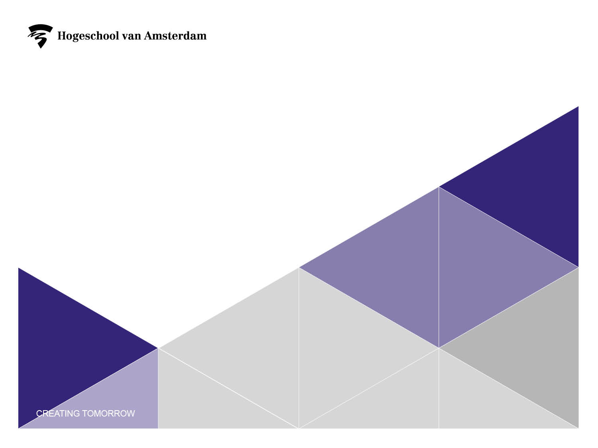

2nd generation Agent-Based modelling for improving apoc operation
Sashiko Shirai
o.s.shirai.reyna@hva.nl

Slide 2

Agenda
AEMC
TAM
AOP
Modelling
Simulator
Next Steps
References

Slide 3
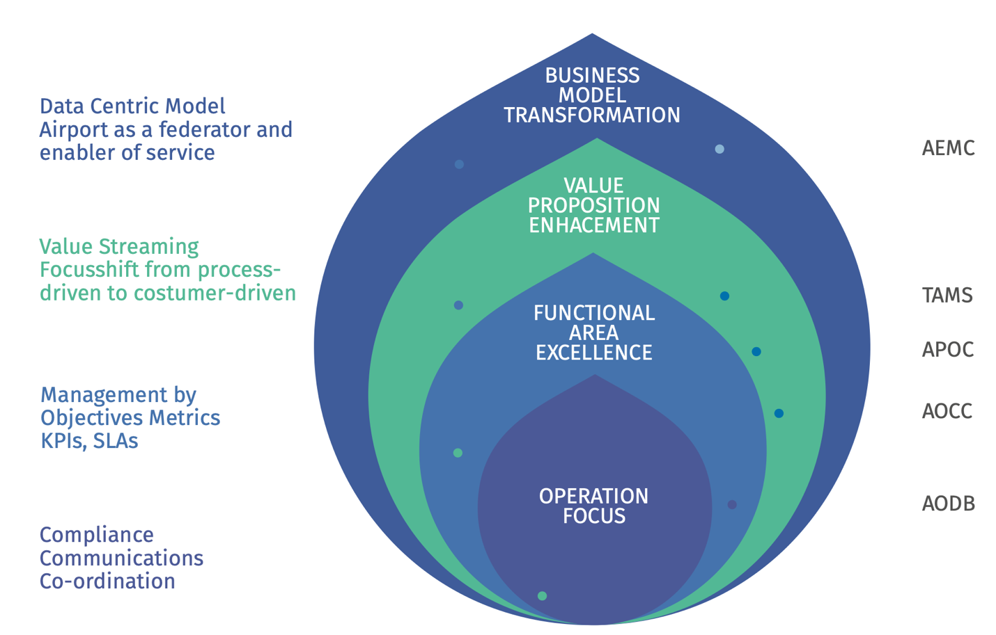
Airport Enterprise Management Centre (AEMC)
Notes:
The Airport Enterprise Management Centre (AEMC) is another new concept that has been researched in the last years. According to the researchers the AEMC is regarded as the next step after APOC and TAM. As various airports have been developing elements of this concept independently, the AEMC has a variety of other names such as, Integrated Control Centre, Airport Command Centre (ACC), Joint Command Centre (JCC) and Airport Operations Centre (APOC). As the researchers call it upgrading an airport to an intelligent airport. Where, “The core of the Intelligent Airport is the Airport Enterprise Management Centre (AEMC) which integrates customer service and finance into the centre’s decision-making processes, enables data sharing and provides a continuum from strategic planning, through all the functional plans to real-time operations. The AEMC serves the entire airport management team and key stakeholders.” (Aviation Strategies International (ASI) Institute, 2018). The overall purpose of an AEMC is to facilitate the achievement of high levels of enterprise performance (operations, business and levels of service). It integrates finance and customer service into the centre’s decision making processes, enables data sharing and provides a continuum from strategic planning, through all the functional plans (Air Service, Risk, Master Plan, Commercial Revenue Plan, etc.) to real-time operations. Perhaps the most significant shift in thinking that promotes the move to an AEMC is that it exists to serve the entire management team and the airport ecosystem, not only airport operations.

Slide 4
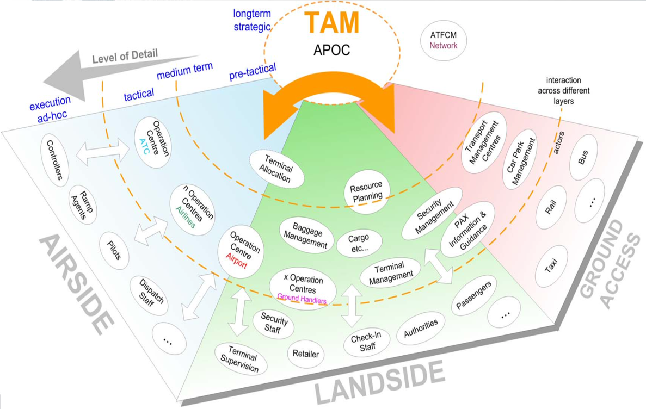
Total Airport Managment(TAM)

Slide 5
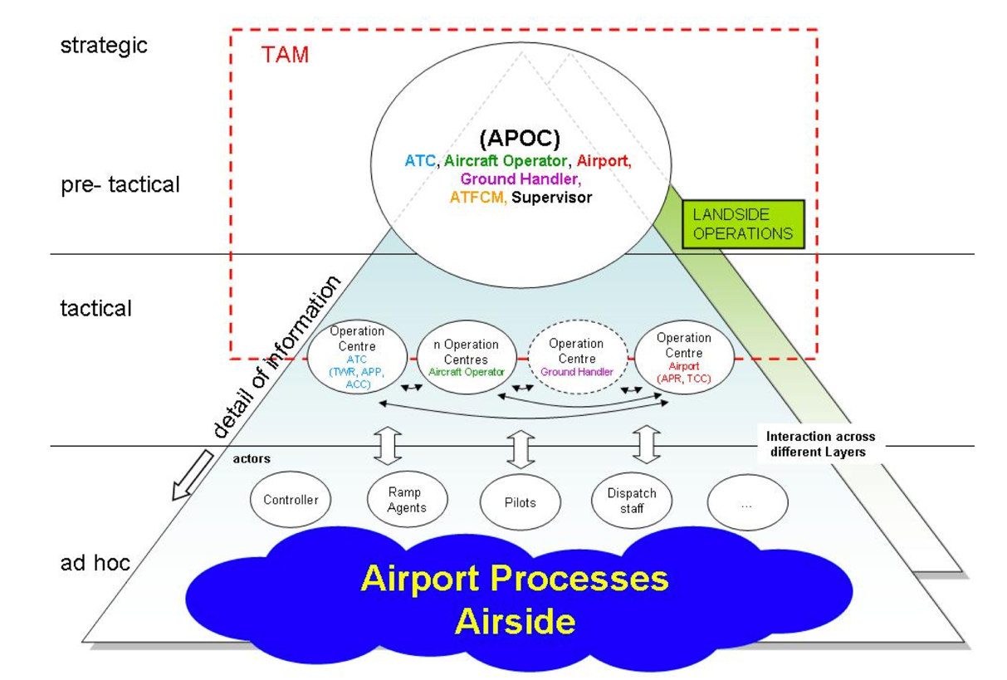
TAM

Slide 6
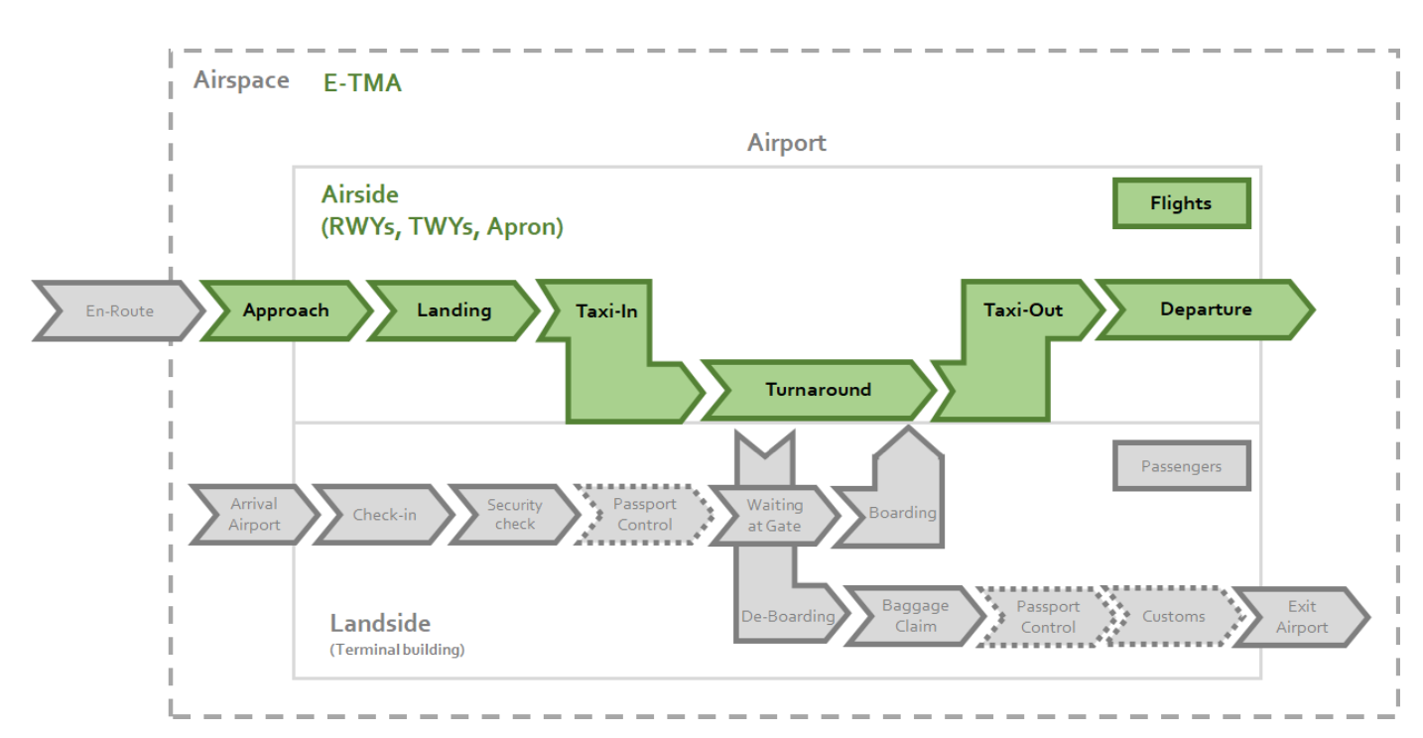

Slide 7
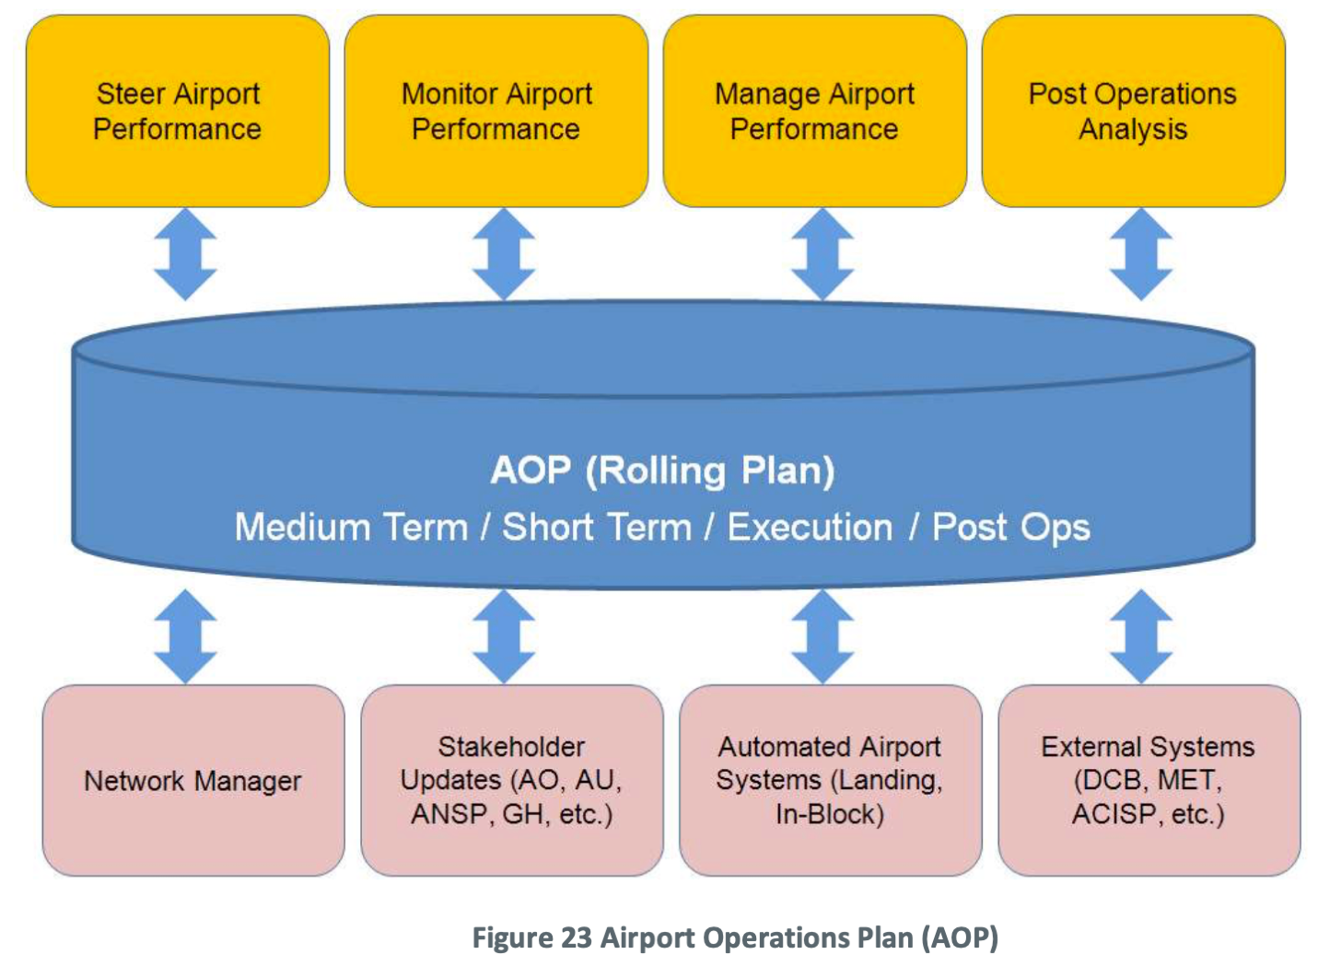


AOP

Slide 8
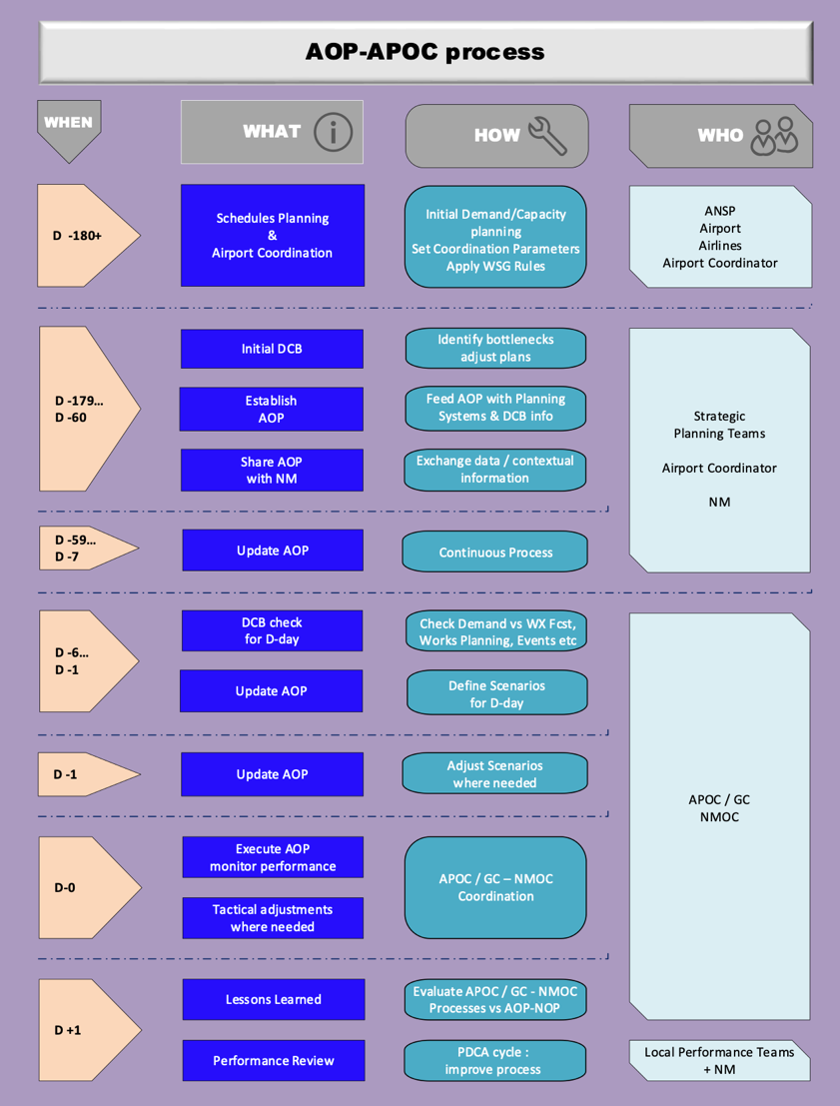

Slide 9
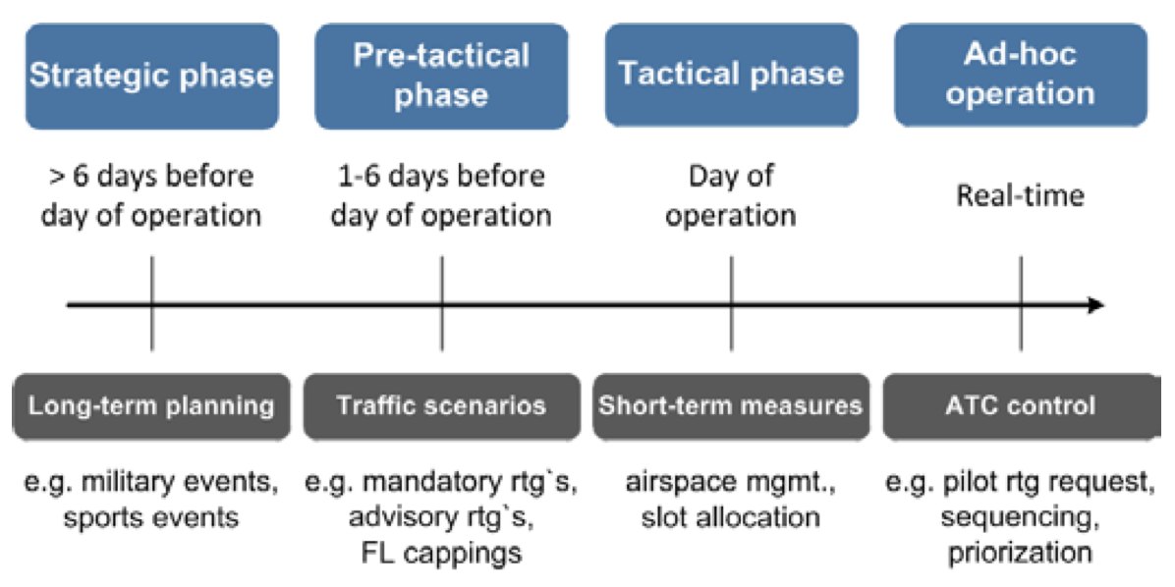
AOP phases

Slide 10
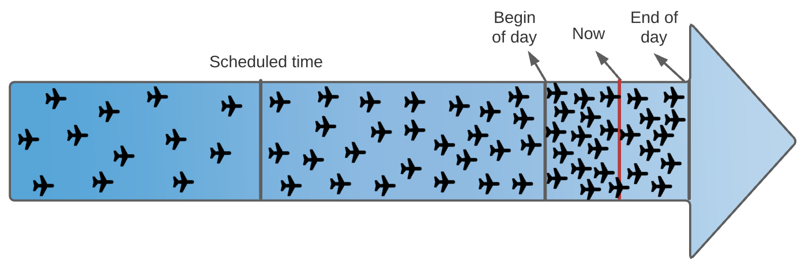
AOP phases
Strategic phase
D-180 to D-7
Pre-tactical phase
D-6 to D-1
Tactical phase
D-0
Ad-hoc
Operation D+1
AOP contains information about all scheduled flights. The information density and accuracy of each flight rises with the approximation of the actual time.

Slide 11
APOC
The problem consists in the integration of airspace, airside operations and the decisions taken on the tactical phase (day of operations). Airspace operations involve landing sequencing while airside operations involve runway, taxiway and terminal operations. The objective, regarding the landing sequencing, is to resolve airspace conflicts and have a smooth arrival flow of aircraft. Regarding airside operations, the objective is to regulate the departure rate aiming at mitigating the congestion at the airport surface. The overall objective is to produce a solution that balances both systems in terms of conflicts.

Slide 12
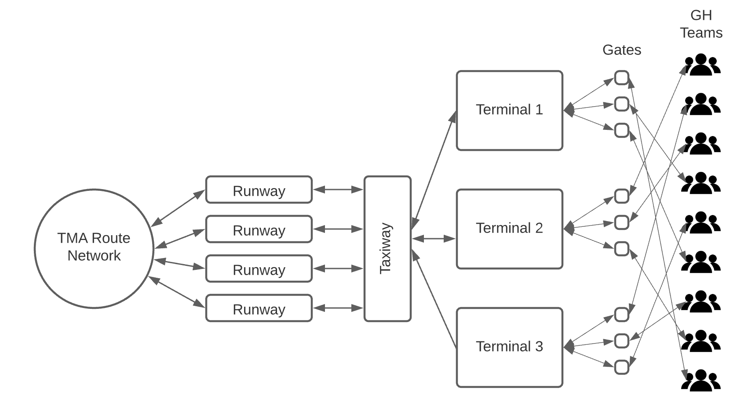

Slide 13
Conflict | Description
Airspace | Aircraft incur conflicts every time a loss of separation minima between two consecutive aircraft is detected. Aircraft that do not respect the order of the sequence along the landing route.
Airside | Airside conflicts are detected, for taxiway and terminal components, when their declared capacity are exceeded (capacity overload).
Runway | Runway conflicts are defined in a similar way as conflicts for the airspace. The only difference is in the values of separation minima which depend on the type of operation on the runway and also on the aircraft type.
Gates | The gate conflicts are detected when they exceeded the capacity or they have overlap of flights.
GH Teams | The Ground Handling teams conflicts are defined in a different way, one is related to the capacity of the teams to serve the different aircraft types and if it’s arrival or departure.

Slide 14
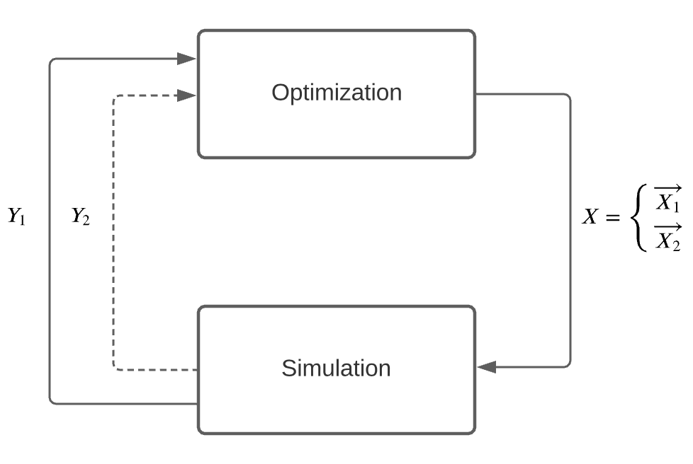
Simulation-Optimization

Slide 15
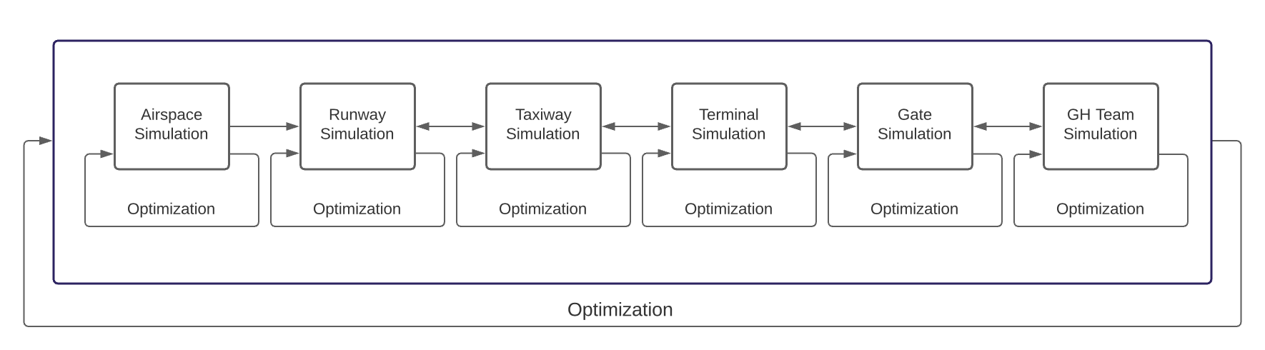
Simulation-Optimization

Slide 16
Simulator
Airport infrastructure
4 runway
Arrivals
Departure
3 Terminals
191 Gates
3 Aircraft types WCT (Light, Medium, Heavy)
100* GH teams
Simulation clock
D-0 24 hours
2 hours window
Flight status
Completed
Active
On-going
Planned

Slide 17
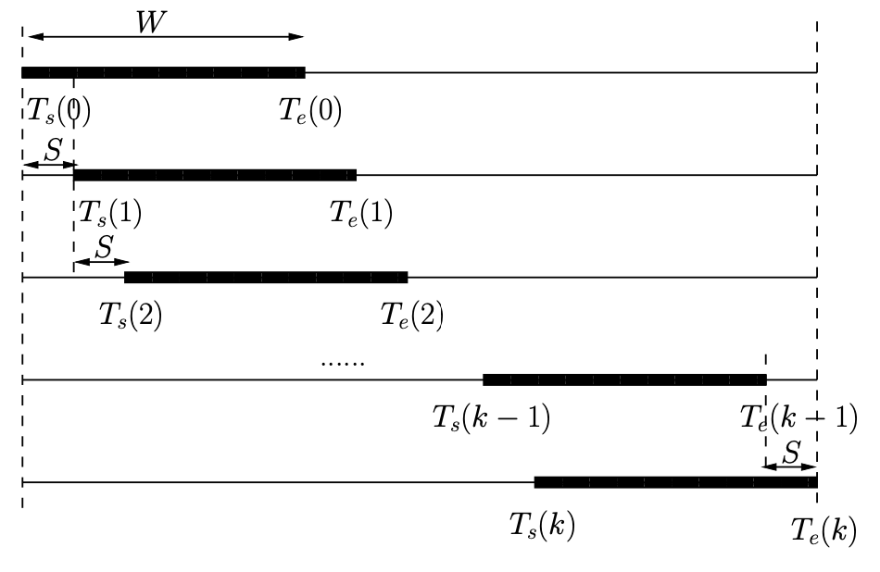
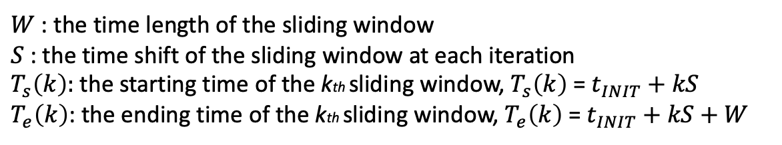
$W$ : the time length of the sliding window
$S$: the time shift of the sliding window at each iteration
$T_{s}\left(k\right):$the starting time of the kth sliding window, $T_{s}\left(k\right)$ = $t_{INIT}+kS$
$T_{e}\left(k\right)$: the ending time of the kth sliding window, $T_{e}\left(k\right)$ = $t_{INIT}+kS+W$

Slide 18
Capacity
Average Taxi-out Duration according to terminal and runway (seconds)
Takeoff runway | Terminal 1 (sec) | Terminal 2 (sec) | Terminal 3 (sec)
27L | 720 | 890 | 880
26R | 1400 | 760 | 710
Average Taxi-in Duration according to terminal and runway (seconds)
Landing runway | Terminal 1 (sec) | Terminal 2 (sec) | Terminal 3 (sec)
27R | 400 | 730 | 680
26L | 535 | 500 | 530

Slide 19
Capacity
Minimum separation according to aircraft categories (NM)
Category |  | Leading Aircraft | Category | Category
 |  | Light | Medium | Heavy
Trailing Aircraft | Light | 3 | 3 | 4
 | Medium | 3 | 3 | 5
 | Heavy | 3 | 5 | 6
Average service time according to aircraft categories and to operations (Min)
Wake Turbulence Category (WtCat) | Arrival Service Time (min) | Departure Service Time (min)
Light | 20 | 30
Medium | 30 | 40
Heavy | 40 | 50

Slide 20
Capacity
Single runway separation requirements according to aircraft categories and to operations (sec)
Operation-Category |  | Trailing Aircraft
 |  | A-H | A-M | A-L | D-H | D-M | D-L
Leading Aircraft | A-H | 96 | 157 | 207 | 60 | 60 | 60
 | A-M | 60 | 69 | 123 | 60 | 60 | 60
 | A-L | 60 | 69 | 82 | 60 | 60 | 60
 | D-H | 60 | 60 | 60 | 96 | 111 | 120
 | D-M | 06 | 60 | 60 | 60 | 60 | 60
 | D-L | 60 | 60 | 60 | 60 | 60 | 60
Number of gates according to terminal
Terminal | Gates
Terminal 1 | 20
Terminal 2 | 125
Terminal 3 | 46
Total | 191

Slide 21
Next Steps
Finish the team assignment
Introduce Airline-business model
Analize results from the simulation-optimization
Prepare the experiments of the economical behaviour approach.

Slide 22
References

Slide 23
References
This project has received funding from the SESAR Joint Undertaking under the European Union’s Horizon 2020 research and innovation programme under grant agreement No 783287. The opinions expressed herein reflect the authors’ view only. Under no circumstances shall the SESAR Joint Undertaking be responsible for any use that may be made of the information contained herein.

